Slide 2
Update on the U.S. Technical Advisory Group to the International Organization for Standardization (ISO) Working Group 16
Dr. Craig Morris
Deputy Administrator
Livestock, Poultry, and Seed Program

Slide 3

International Organization for Standardization (ISO)
Founded in 1947
Private organization that develops voluntary international standards
Participants are called national standards bodies or member bodies
  One member per country, which can be a government or private organization.
  164 countries participate

Slide 4
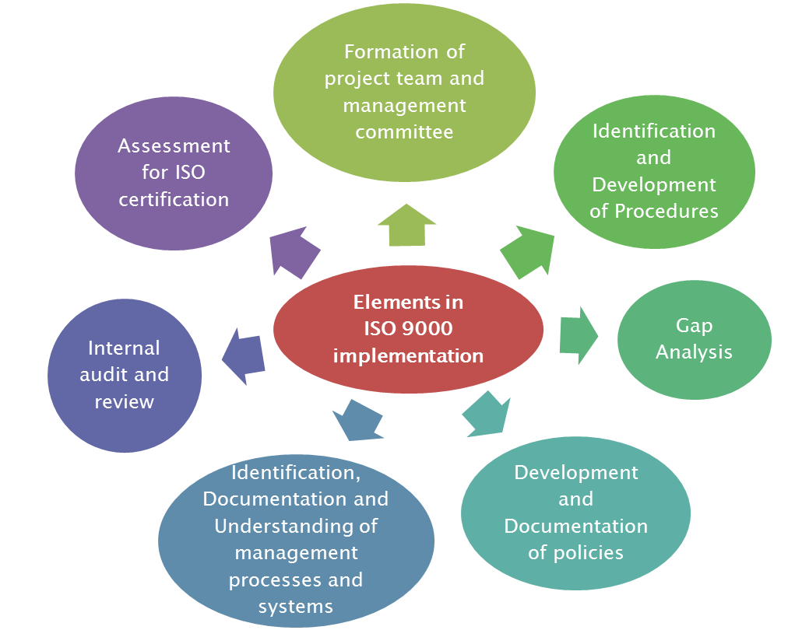
ISO Standards
Develop standards for activities such as agriculture, construction, mechanical engineering, information and communications technology
Popular ISO Standards
  ISO 9000 – Quality Management
  ISO 26000 – Social Responsibility
  ISO 22000 – Food Safety Management

Slide 5
OIE and ISO
  ISO – OIE Memorandum of Understanding
    OIE is the World Animal Health Organization
    MOU allows ISO to aid in implementation of OIE animal health and welfare standards
OIE Animal Welfare Standards
Next Standard to be developed – Swine Production System
All Species | Production System by Species
General Principles | Beef Cattle
Slaughter | Dairy Cattle
Transport (Air, Land, Sea) | Broiler Chickens

Slide 6
ISO Structure

Slide 7
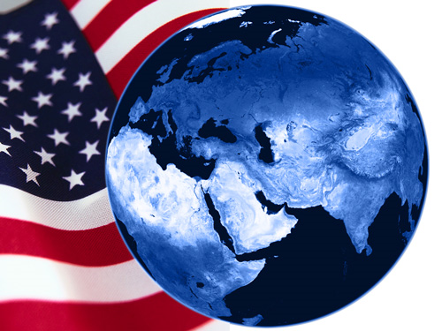
US TAG
Administrated by the American Oil Chemists Society (AOCS)
  Reports to the American National Standards Institute (ANSI), the US representative at ISO
USDA chairs the US TAG
39 voting members representing a variety of stakeholders
Work to achieve consensus for a US TAG position

Slide 8
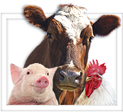
Working Group 16
Established in late 2012
New Work Item Proposal (NWIP) adopted in 2014
Final product to be a technical specification (TS)
Drafting Group created to write the initial ISO TS 34700

Slide 9

TS Intent
Scope is to implement OIE code on animal welfare, not develop new guidelines
Key component – development of an animal welfare plan
Plan must meet, at least, the OIE code to be ISO compliant
Plan can incorporate other private standards and codes of practice, as long as they meet OIE code
Notes:
OIE Code covers
Transport
Slaughter
Species specific Production Practices
Beef cattle, Broilers, Dairy

Slide 10

Timeline
      April 2015 - Initial draft completed
      May 2015 - WG meeting
      July 2015 – Final draft expected
      Summer 2015 – Member bodies to discuss draft
      December 2015 – WG expected to vote on the final draft
      January 2016 – If passed, the TS will be put up for a voted by full ISO membership

Slide 11
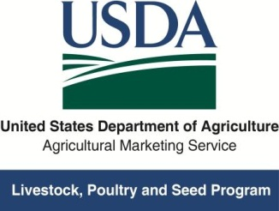
Craig Morris, Ph.D.
Deputy Administrator
Livestock, Poultry, & Seed Program
Craig.Morris@ams.usda.gov
…or visit us on the Web at: http://www.ams.usda.gov/AMSv1.0/LivestockandSeed
Thank you!

